Slide 1


SECTOR ANALYSIS STOCK TREND PREDICTION

Slide 2
PROBLEM STATEMENT
Aim of the project : Comprehensively investigate the most influential macro, micro and fundamental factors of stock movements in different sectors namely
Finance
Information Technology
Pharmaceuticals
Energy

Slide 3
PROBLEM STATEMENT
Project includes 12 companies, 3 under each sector
Finance Pharmaceuticals
J.P.Morgan AbbVie Inc
Wells Fargo Bristol-Myers Squibb Co
Citi Group Pfizer Inc
Information Technology Energy
Apple Inc Occidental Petroleum Corporation
Intel Corporation Marathon Oil Corporation
HP Company ConocoPhillips

Slide 4
DATA PREPARATION
Data collection
Stock prices for 4 sector companies for 20 yrs
Open, High, Close etc
Micro economic factors, Fundamental factors and macro economic factors
Price to book value
Debt equity ratio
Consumer Price Index (CPI)
Gross domestic product (GDP)
Short term interest rate (ST)

Slide 5
DATA PREPARATION
Collect Data
Web scraping – Selenium – Ycharts – 20 yrs
Yahoo finance
Daily Vs Monthly Vs Quarterly
Converted monthly values to daily using R code
Converted quarterly values to daily using R code

Slide 6
DATA PREPARATION
Missing Values
Recover The Values - Formula to calculate a factor
P/E Ratio – Price of Stock/Earning Per Share
Return On Invested Capital - Net Income - Dividend / Equity
Listwise Deletion - Remove missing values
Drop data without substantial loss of statistical power as the number of missing values were very less

Slide 7
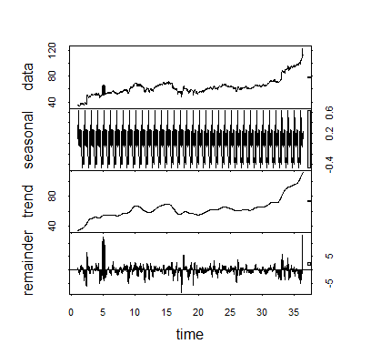
DATA ANALYSIS
Exploratory Data Analysis
Scatter plot
Correlation plot
Seasonality
Stationary

Slide 8
DATA ANALYSIS
Algorithms
Timeseries – Price Prediction
Regression – Price Prediction
Linear regression
Gradient Boost
Decision Tree
Classification – Trend prediction
Logistic Regression
Naïve Bayes
Random forest
KNN

Slide 9
DATA ANALYSIS
TIME SERIES ANALYSIS
Plot ACF PACF
Check if Stationary
ARIMA output using auto.arima function
Forecast time series

Slide 10
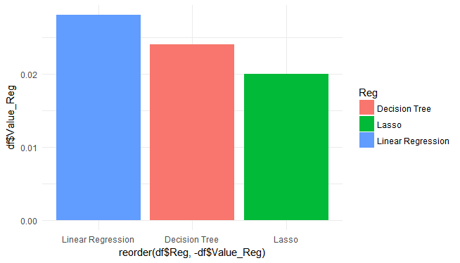
DATA ANALYSIS
REGRESSION ANALYSIS AND METRIC
Normalize the numerical data
Stratified sampling
Cross validation to Fit model
Predict
RMSE Lasso – ~ 0.020
RMSE Linear Regression – ~ 0.028
RMSE Decision Tree – ~ 0.024

Slide 11
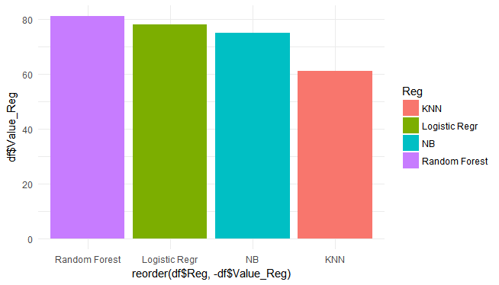
DATA ANALYSIS
CLASSIFICATION ANALYSIS AND METRICS
Create a Class variable based on a threshold
Normalize the data
Stratified Sampling
Cross validation to Fit model
Predict
Accuracy Naïve Bayes – ~ 75%
Accuracy Random Forest – ~ 81%
Accuracy Logistic Regression – ~ 78%
Accuracy KNN – ~ 61%
ROC curve and AUC in R Shiny

Slide 12
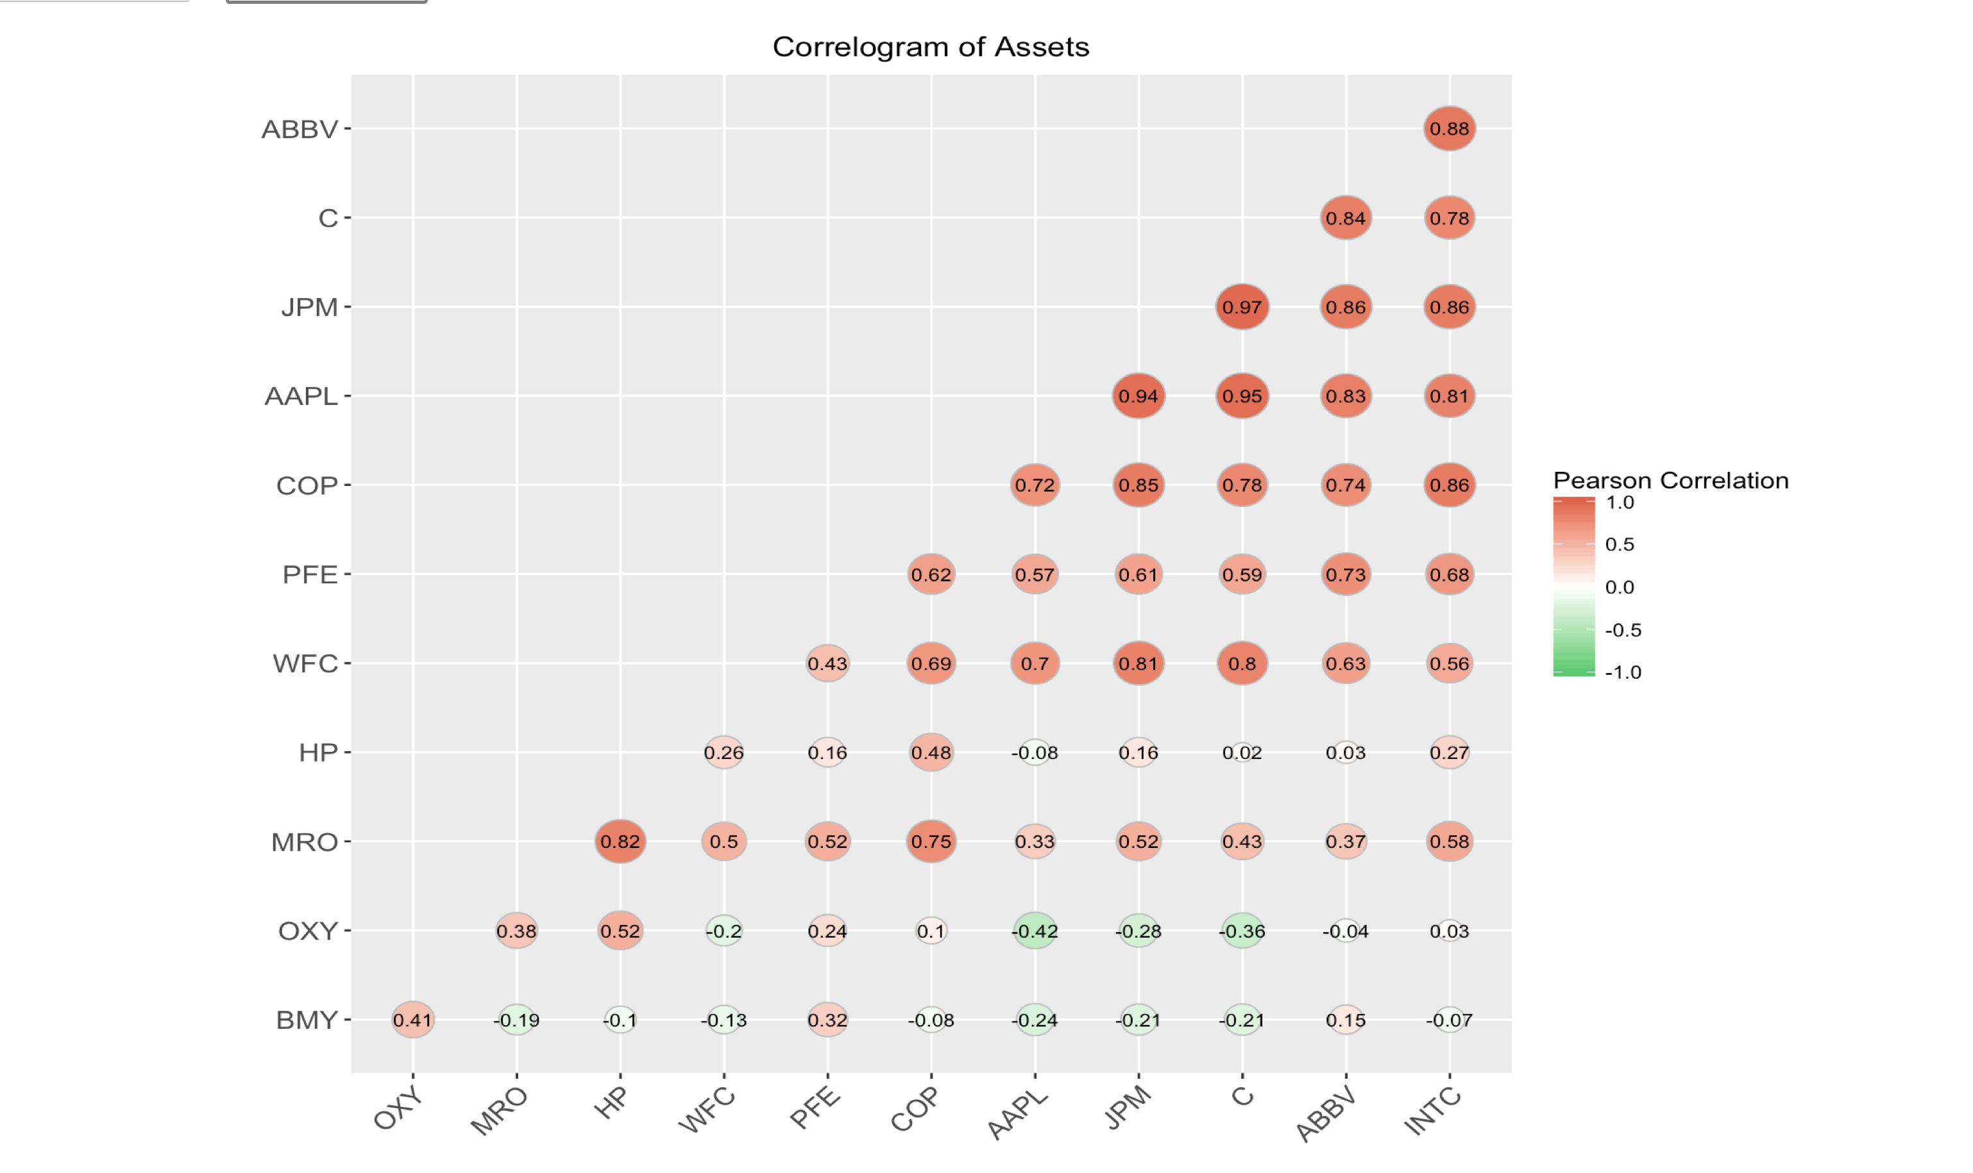
SECTOR ANALYSIS

Slide 13

SECTOR ANALYSIS - FINANCE
HIGH, LOW, OPEN
MARKET CAPITAL
LT
CPI
GDP

Slide 14

SECTOR ANALYSIS - IT
HIGH, LOW, OPEN
MARKET CAPITAL
EV REVENUE
BOOK VALUE
GDP

Slide 15

SECTOR ANALYSIS - PHARMACEUTICAL
HIGH, LOW, OPEN
MARKET CAPITAL
CURRENT RATIO
BOOK VALUE
GDP, GNP

Slide 16

SECTOR ANALYSIS - ENERGY
HIGH, LOW, OPEN
MARKET CAPITAL
EV REVENUE
EV EBIT
CPI

Slide 17
DEPLOYMENT
R Shiny – Sample Algorithm – Logistic Regression
R Console – Sample Algorithm - Timeseries

Slide 18
BEST PRACTICES
Few Technical Best Practices
Normalize the numeric data
Stratified Sampling
Cross validation
Few Project Management Best Practices
GitHub - https://github.com/IITDPA/StockAnalysis
SourceTree
Asana

Slide 19

THANK YOU
HAPPY INVESTING

